Slide 1
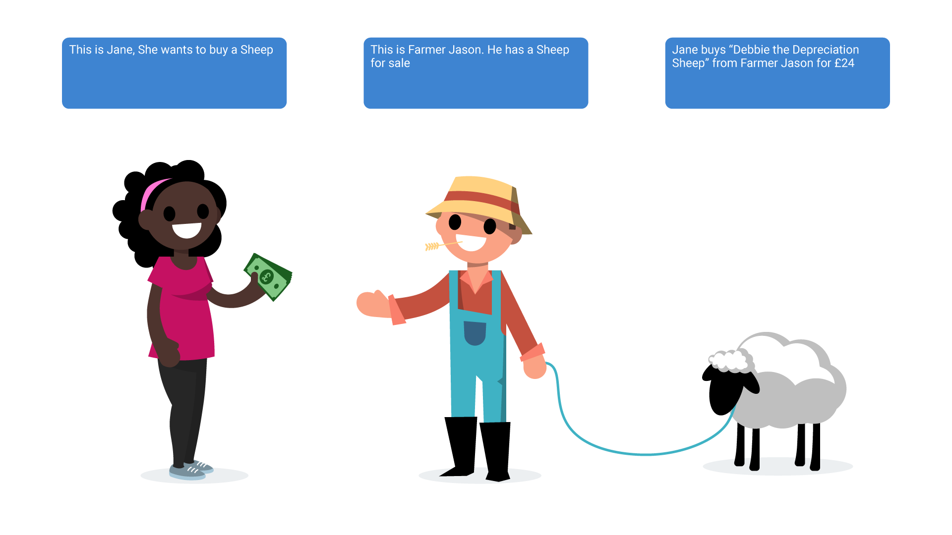

CAPEX
© Tech Marionette Ltd 2019

Slide 2
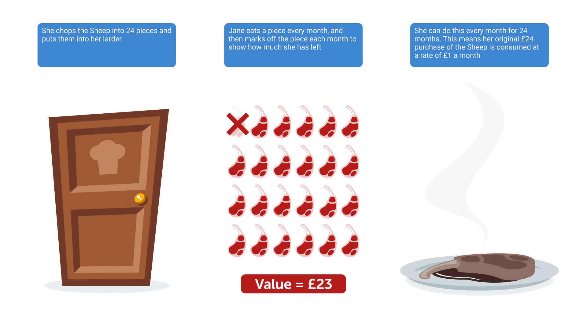
DEPRECIATION
© Tech Marionette Ltd 2019

Slide 3
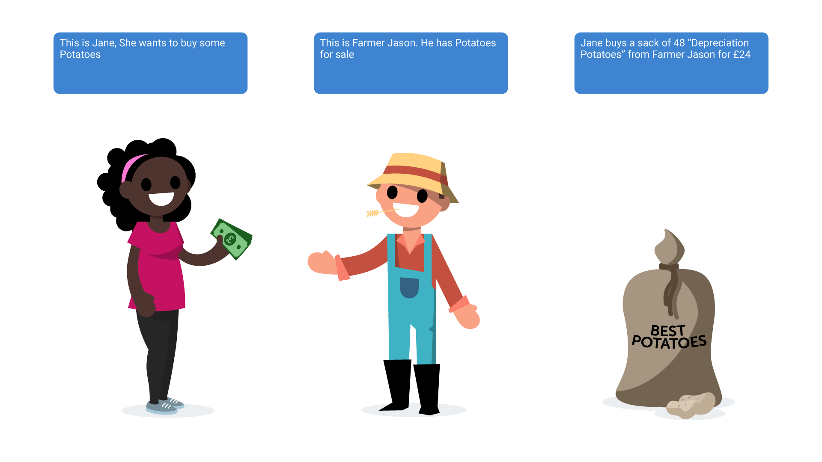
CAPEX
© Tech Marionette Ltd 2019

Slide 4
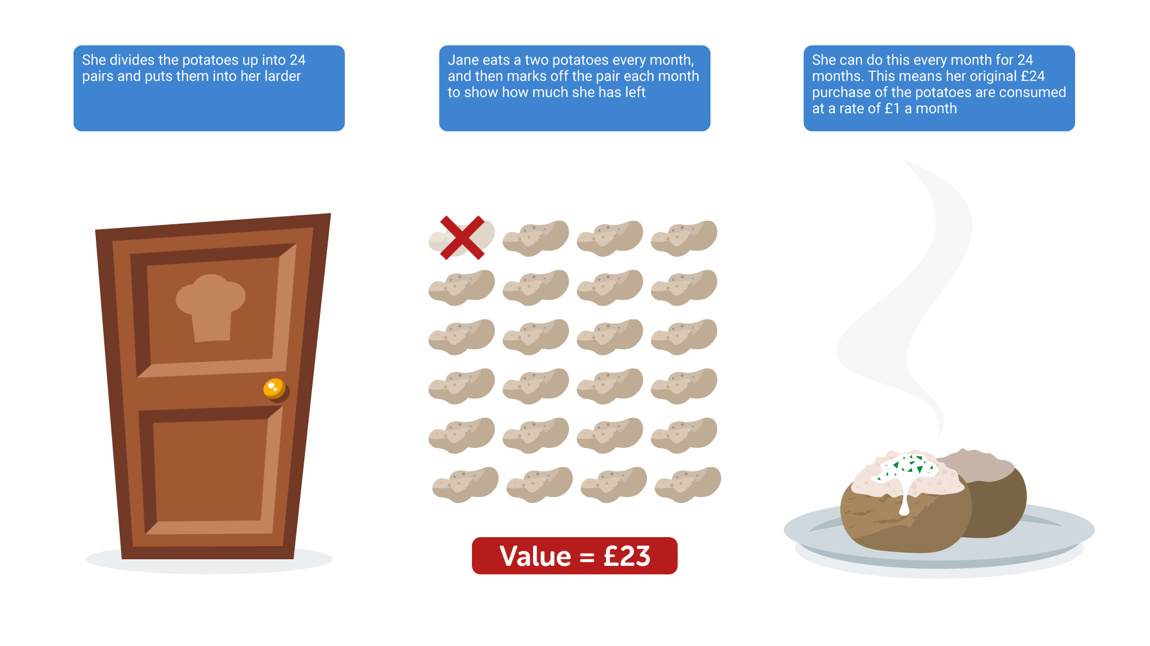
DEPRECIATION
© Tech Marionette Ltd 2019

